Slide 1
Blueprint Downtown Steering Committee Meeting
Assembly Chambers
January 22, 2020

Slide 3
Welcome
Roll Call
Approval of Minutes
  Next meeting
Public Participation
Steering Committee Updates
Draft Chapter 8: Transportation, Streetscape & Parking
Public Participation
Committee Comments
Adjournment

Slide 4
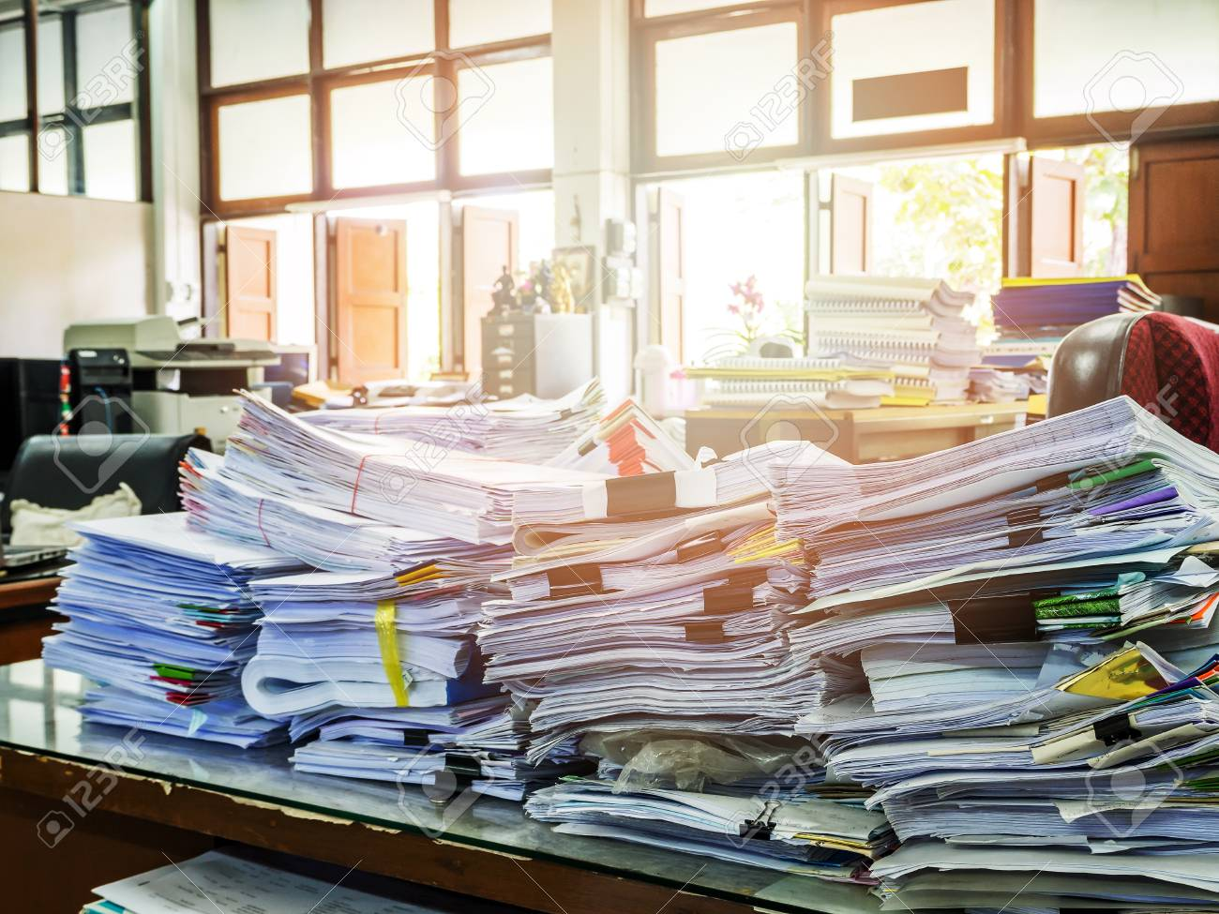
Transportation, Streetscape, and Parking
Incorporates recommendations of previous plans Sections
  Review the visioning public concerns/consultant recommendations
  Summarized relevant plans reviewed
    Land Use Code requirements
    2001 Area-wide Transportation Plan (need to review)
    2010 Downtown Juneau Parking Management Plan
    (plus other parking studies since 1999)
    2012 Willoughby Plan
    2013 Comprehensive Plan

Slide 5
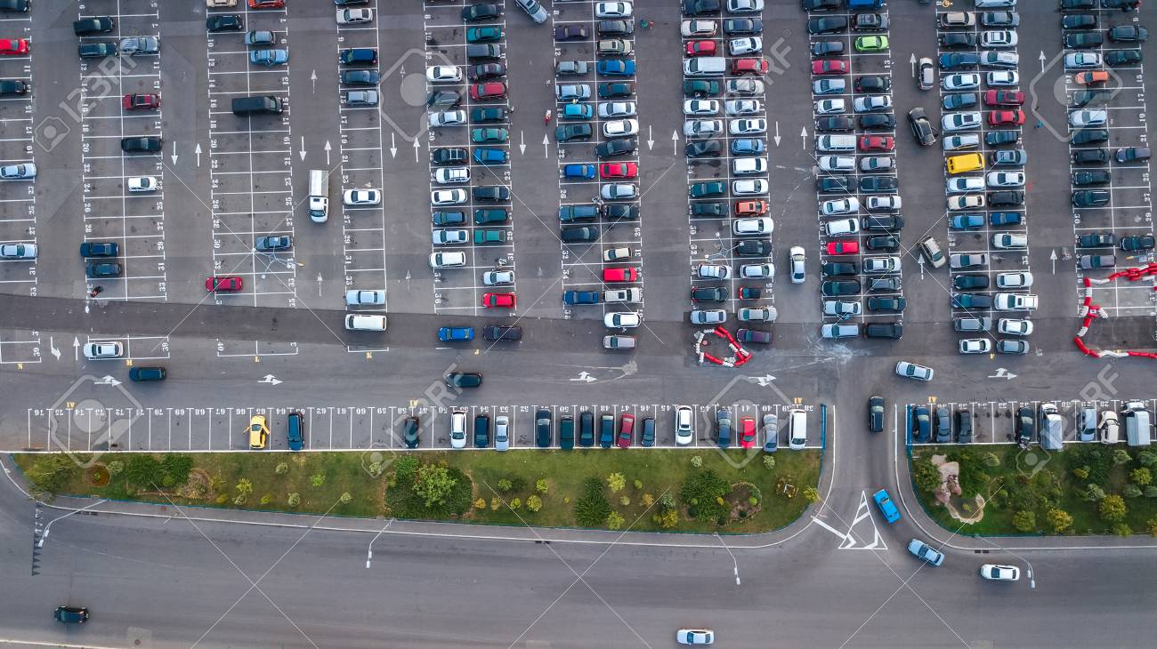
Observations in the 2010 Downtown Juneau Parking Management Plan
Since the 60s at least one parking related study or report has been produced.
In the past, there was a period where there was no parking requirement for new buildings in downtown Juneau
Public parking has been significantly increased
Parking meters have come and gone
Perception that parking is hard to find still exists
Parking studies over the years identify ‘a misuse of existing spaces, and not a shortage of parking overall’.

Slide 6
Outcome from tonight
Discussion on requested topics.
What do you want to change?
Anything in existing plans or vision that you particularly want to emphasize/prioritize?
What is missing that they expected to see?
Recommendations will be compilation of what is contained in existing plans but noting what has been addressed
Add any new recommendations from group

Slide 7
Vision Report
Use some of Downtown’s vacant lots to add more parking in aesthetically pleasing multi-level parking garages.
Create Park and Ride lots in the Valley and Douglas for transit and carpools to and from Downtown; incentivize large employers to use.
Stop investing in parking structures. Redevelop areas now used for surface parking lots, emphasizing transit, car pools, car-sharing, bicycling, and walking.

Slide 8
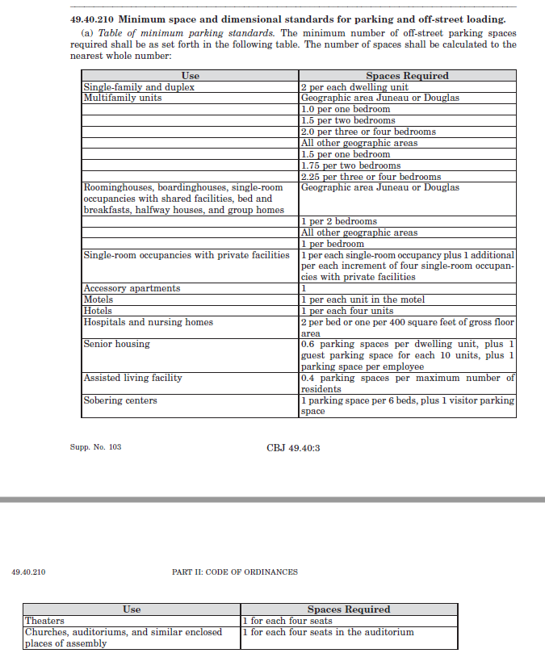
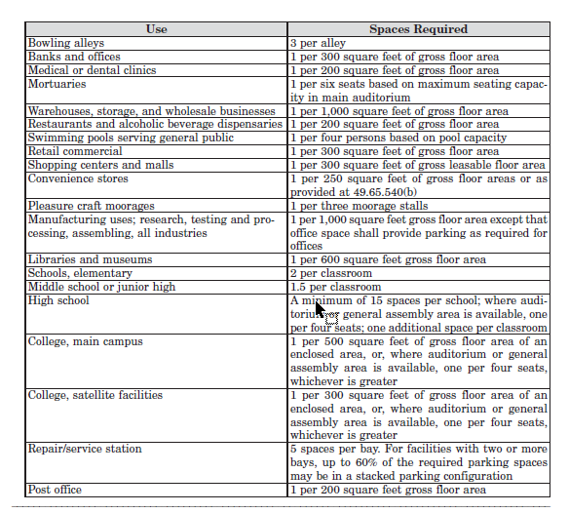
Land Use Code
Some design standards but do they need to go further to ensure Historic Guidelines/Willoughby Plan are adhered to?

Slide 9
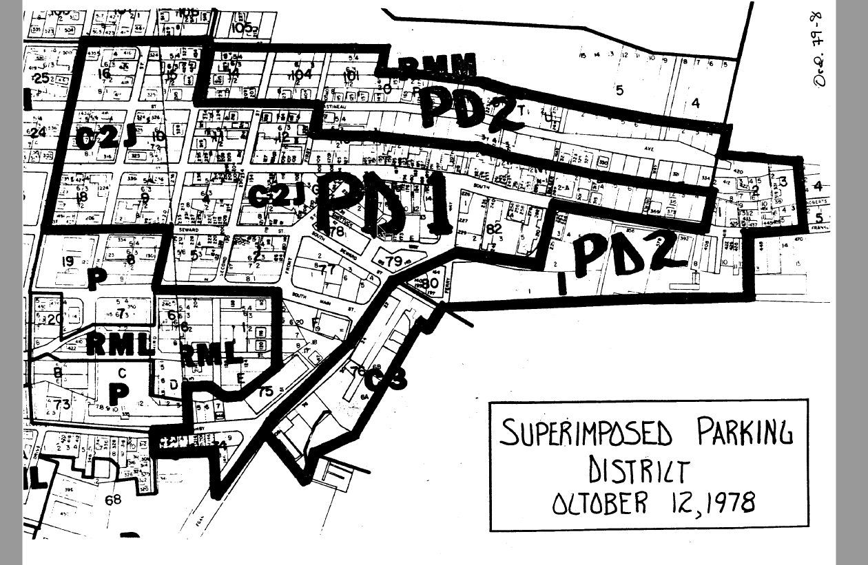
Land Use Code - Parking Districts (1)

Slide 10
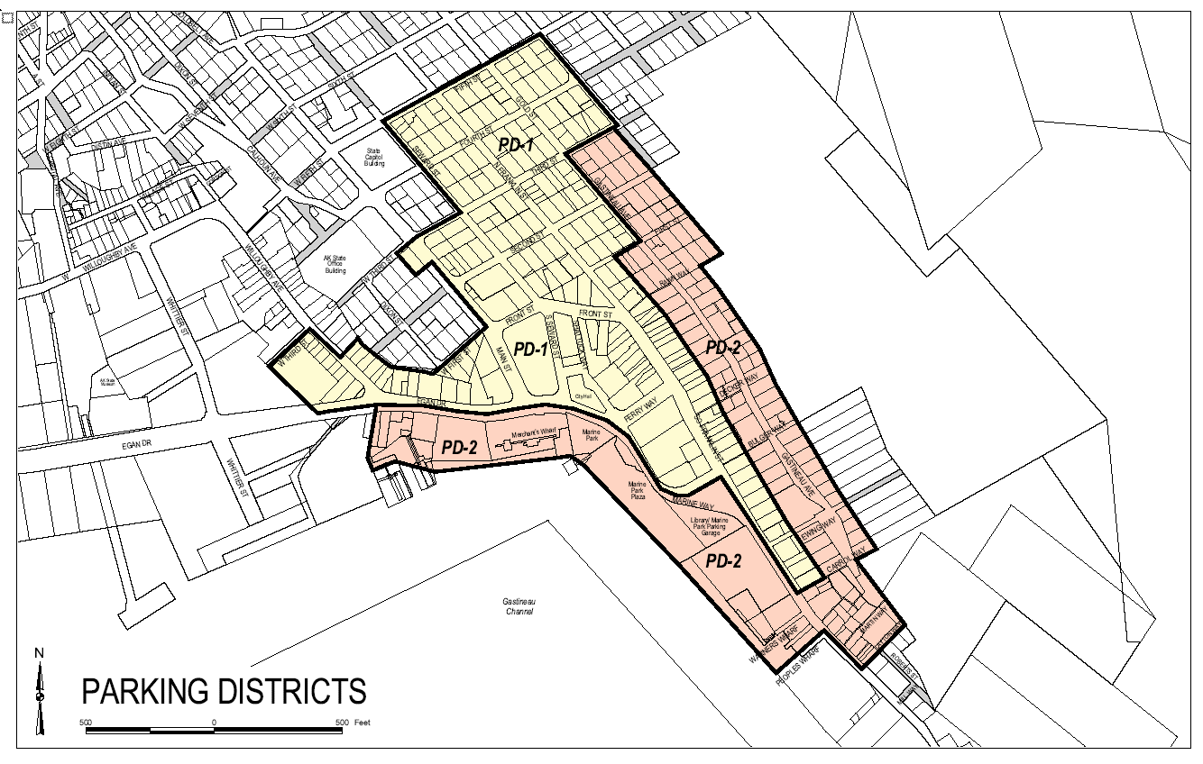
Land Use Code - Parking Districts (2)

Slide 11
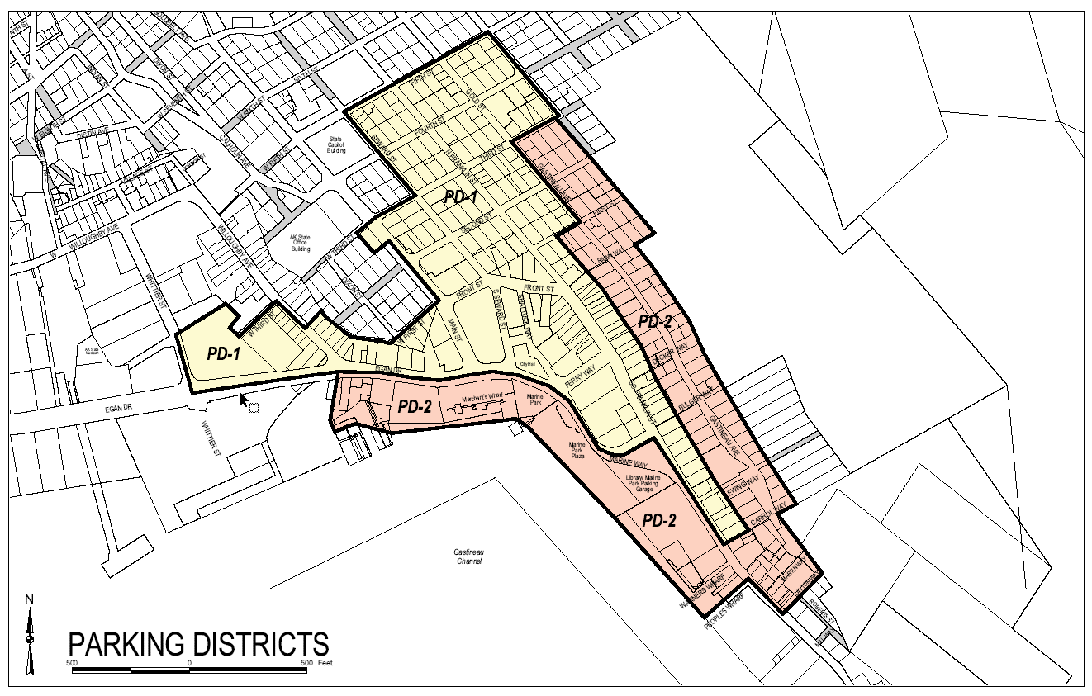
Land Use Code - Parking Districts (3)

Slide 12
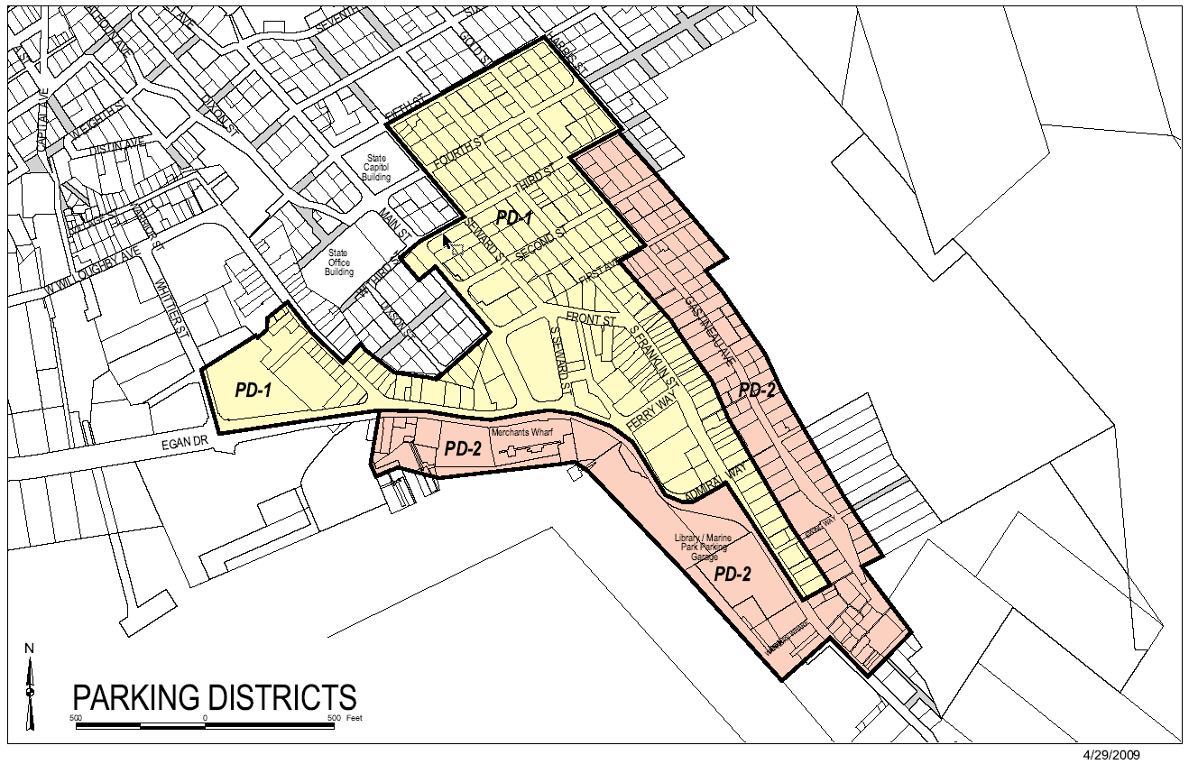
Land Use Code - Parking Districts (4)

Slide 13
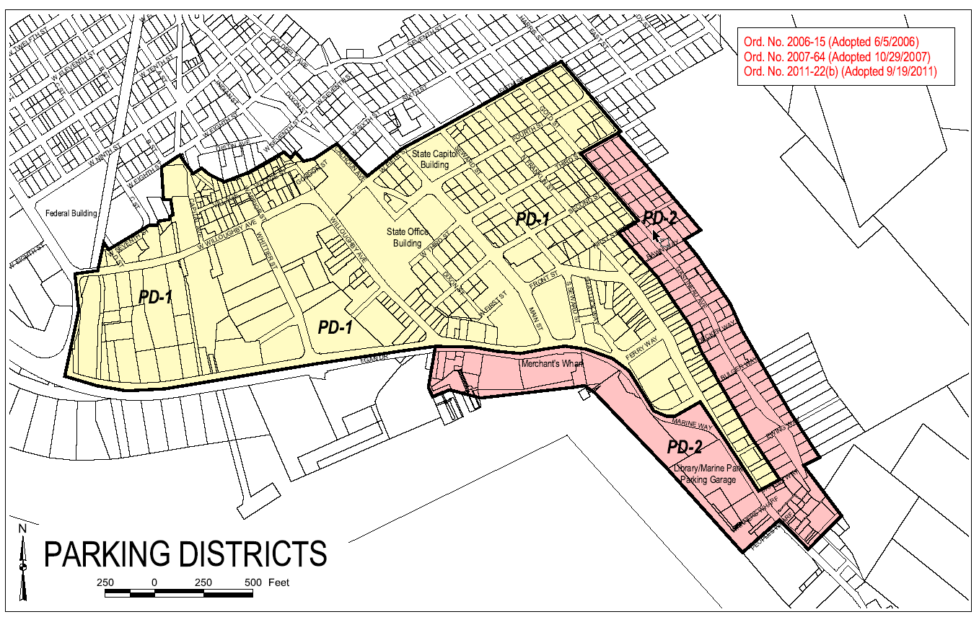
Land Use Code - Parking Districts (5)

Slide 14
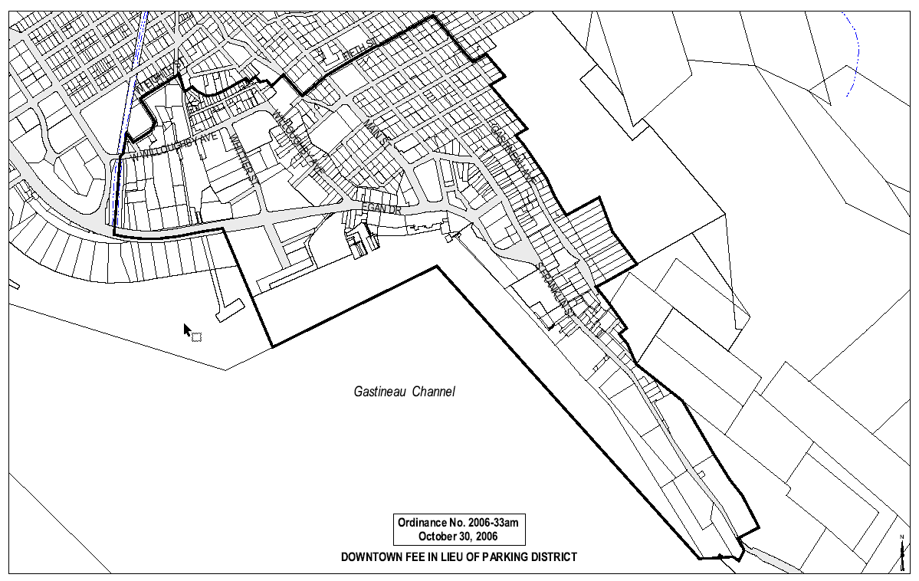
Land Use Code – Fee in lieu district
~$10,000 for commercial space and ~$5,000 for residential
Parking waivers for outside fee in lieu

Slide 15
2010 Downtown Parking Mgmt Plan
1. Reduce the number of vehicles that are parked all day (long-term) in hourly (short-term) spaces.
2. Ensure that both the Marine Park Parking Garage and the Downtown Transportation Center Parking Garage (under construction) are utilized at or near capacity year-round.
3. Ensure that on-street parking spaces are available near all destinations at all times of the day for use by visitors who only need short-term parking.
I. Manage on- and off-street parking resources so as to ensure that both long- and short-term parkers can find parking suitable to their needs at all times.
II. Manage parking as a component of a multi-modal transportation system, recognizing that adequate parking cannot be supplied at any destination in the downtown area for peak demand, and that walking, bicycling, use of shuttles/buses, carpooling, and other transportation tools are part of the solution to any parking problem.
III. Parking management must be simple enough that parkers can easily know how long they may park in any given space, and what the fee for parking in that space (if any) is.

Slide 16
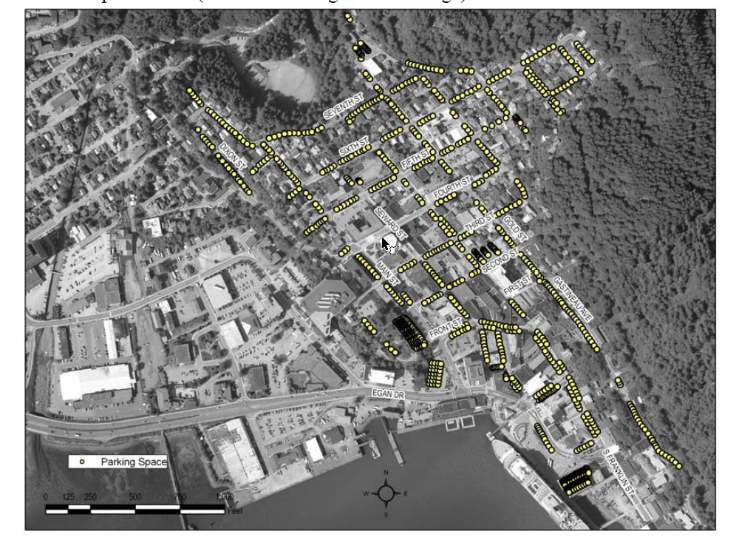
2010 Downtown Parking Mgmt Plan

Slide 17
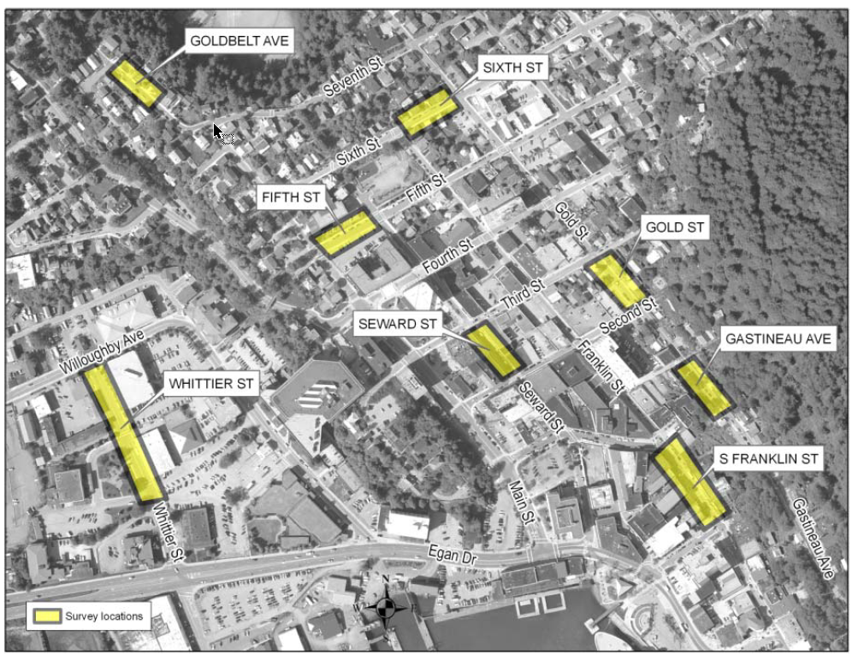
2010 Downtown Parking Mgmt Plan

Slide 18
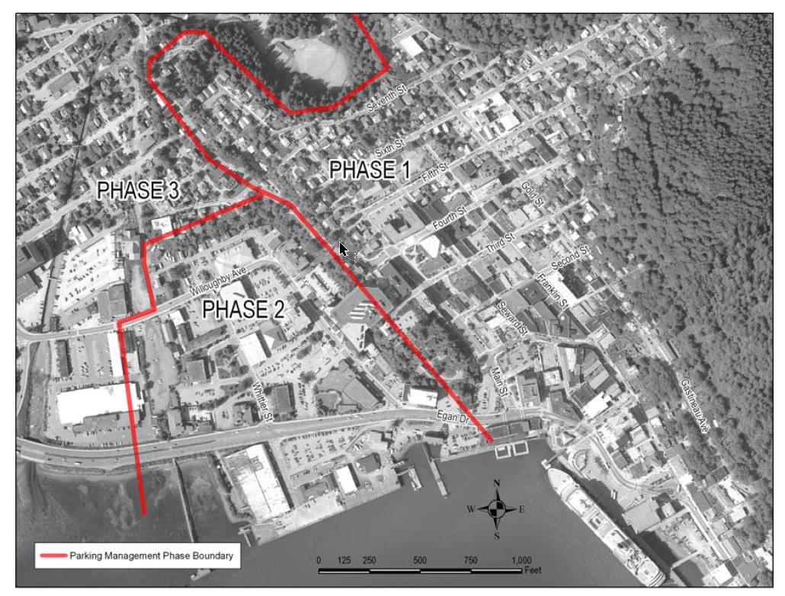
2010 Downtown Parking Mgmt Plan

Slide 19
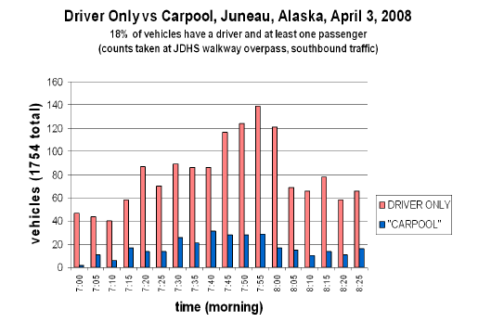
2010 Downtown Parking Mgmt Plan

Slide 20
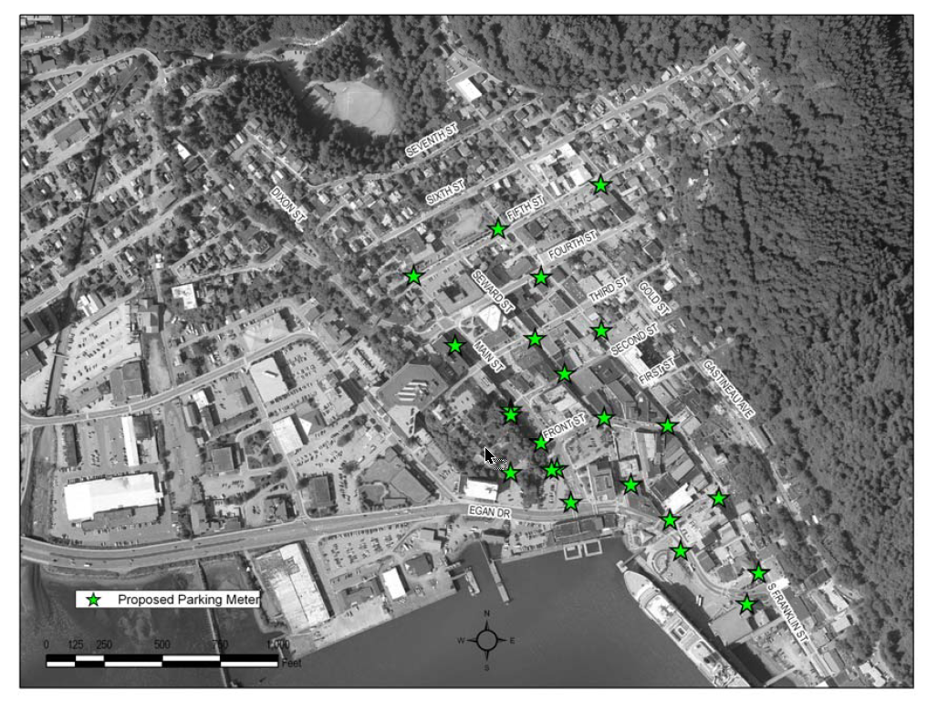
2010 Downtown Parking Mgmt Plan

Slide 21
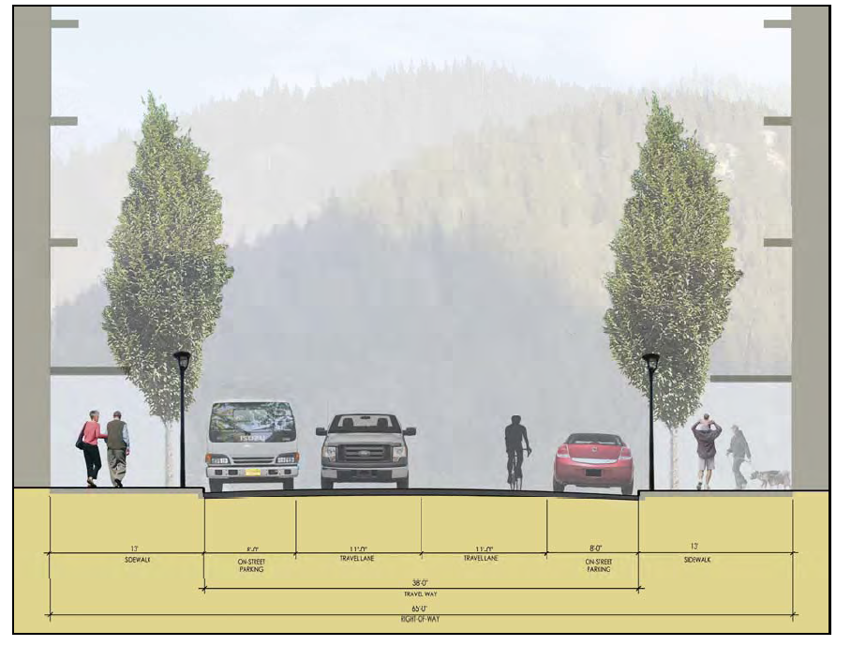
2012 Willoughby Plan

Slide 22
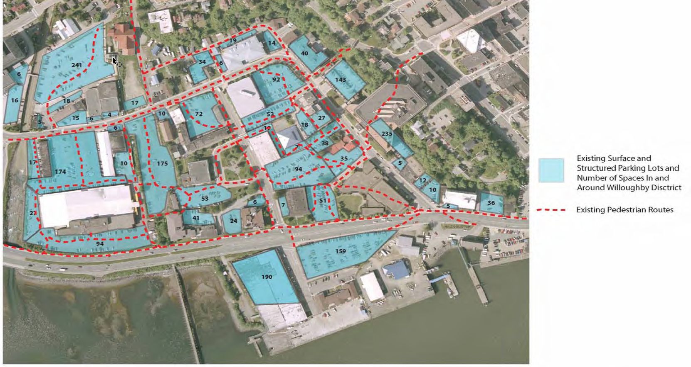
2012 Willoughby Plan

Slide 23
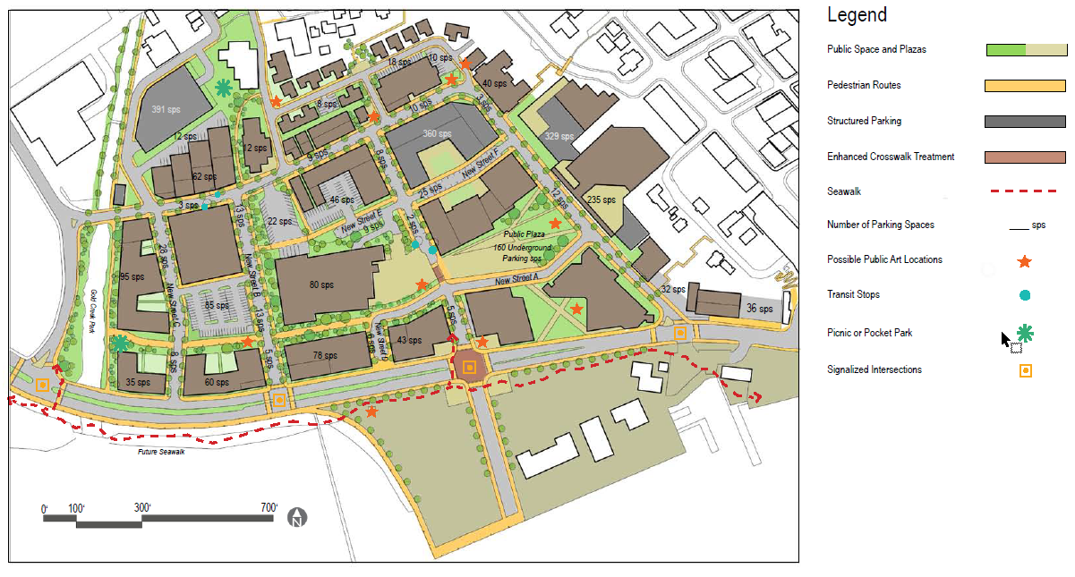
2012 Willoughby Plan

Slide 24

2013 Comprehensive Plan
Guidelines provided for parking management in Downtown sub-area (see Pages 21-23 for list)
Also policy on removal of on-street parking to create off-street parking spaces (have to get more than you take away)

Slide 25
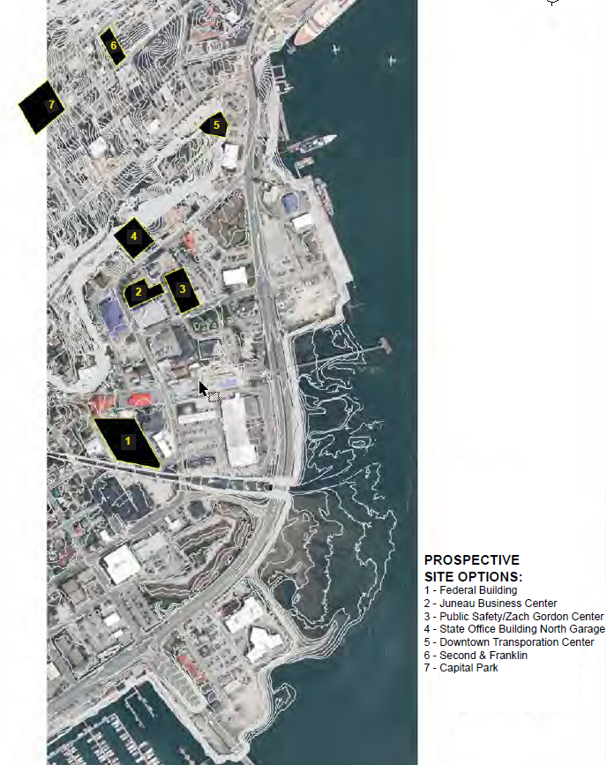
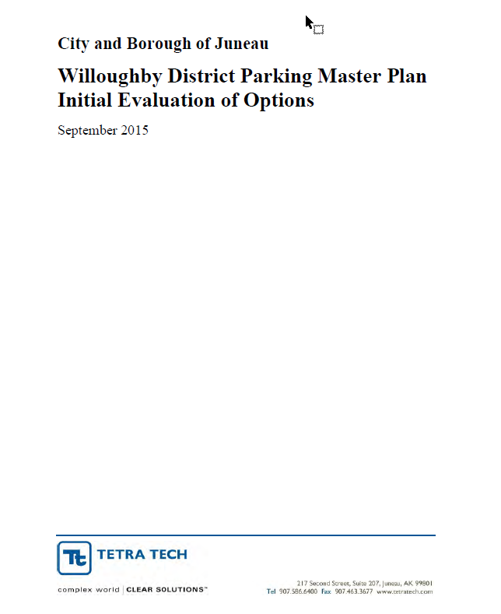
2015 Willoughby District Parking Master Plan (Phase 1)

Slide 26
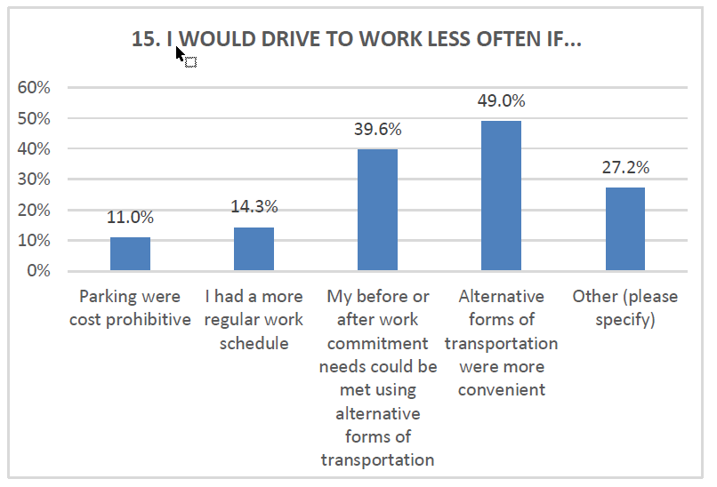
2015 Willoughby District Parking Master Plan (Phase 1)

Slide 27
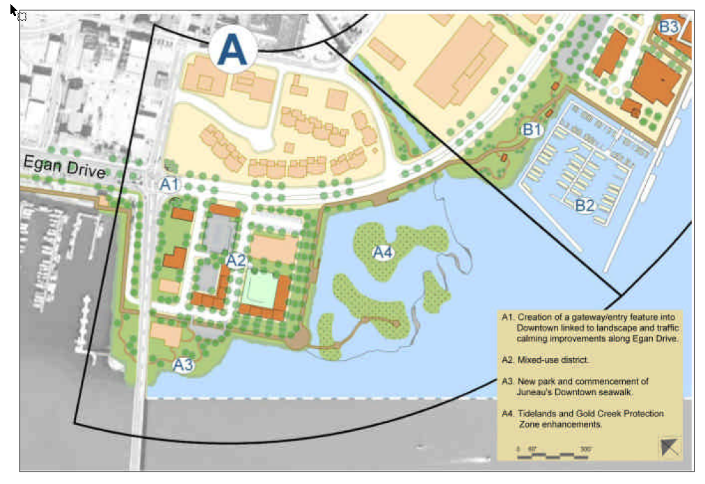
2004 Long Range Waterfront Plan

Slide 28
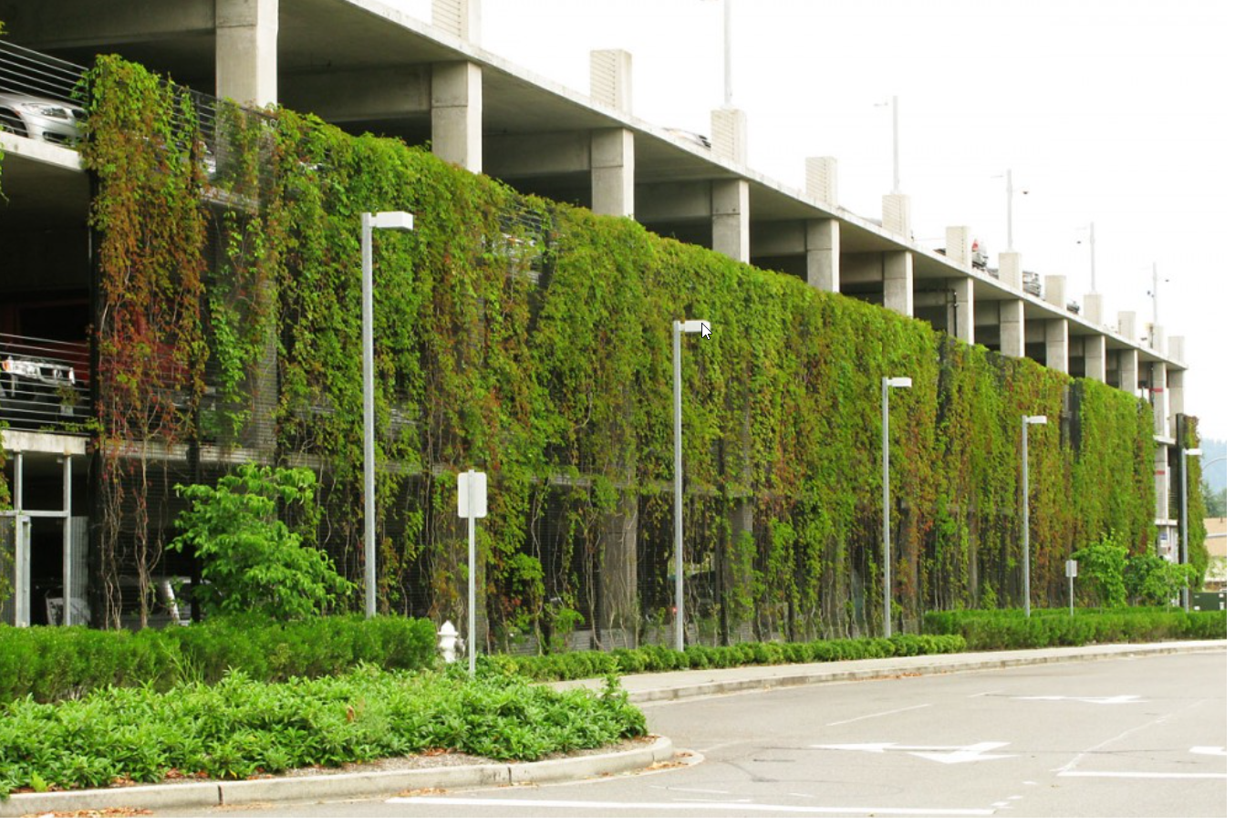
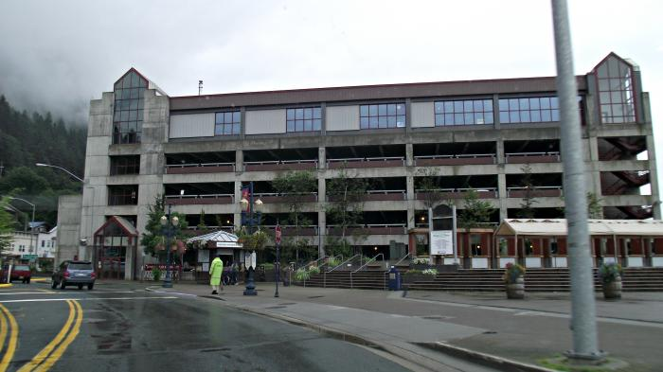
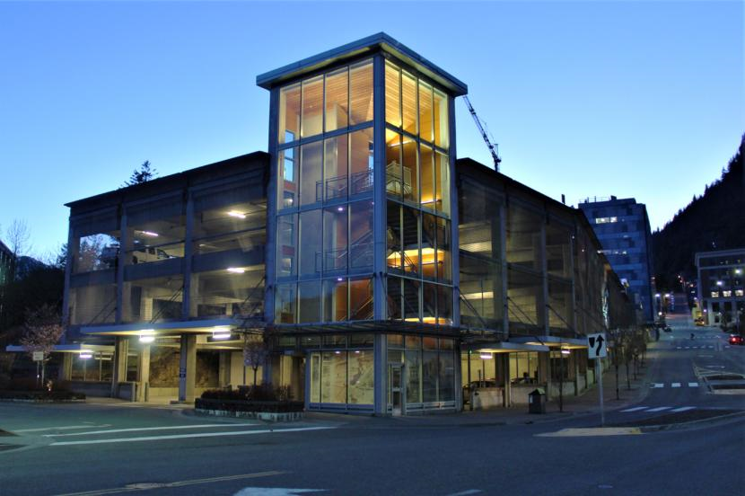
2004 Long Range Waterfront Plan

Slide 29
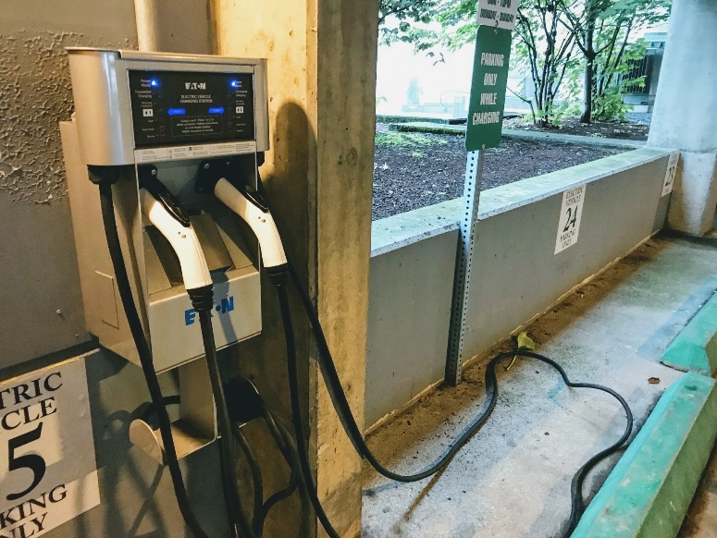
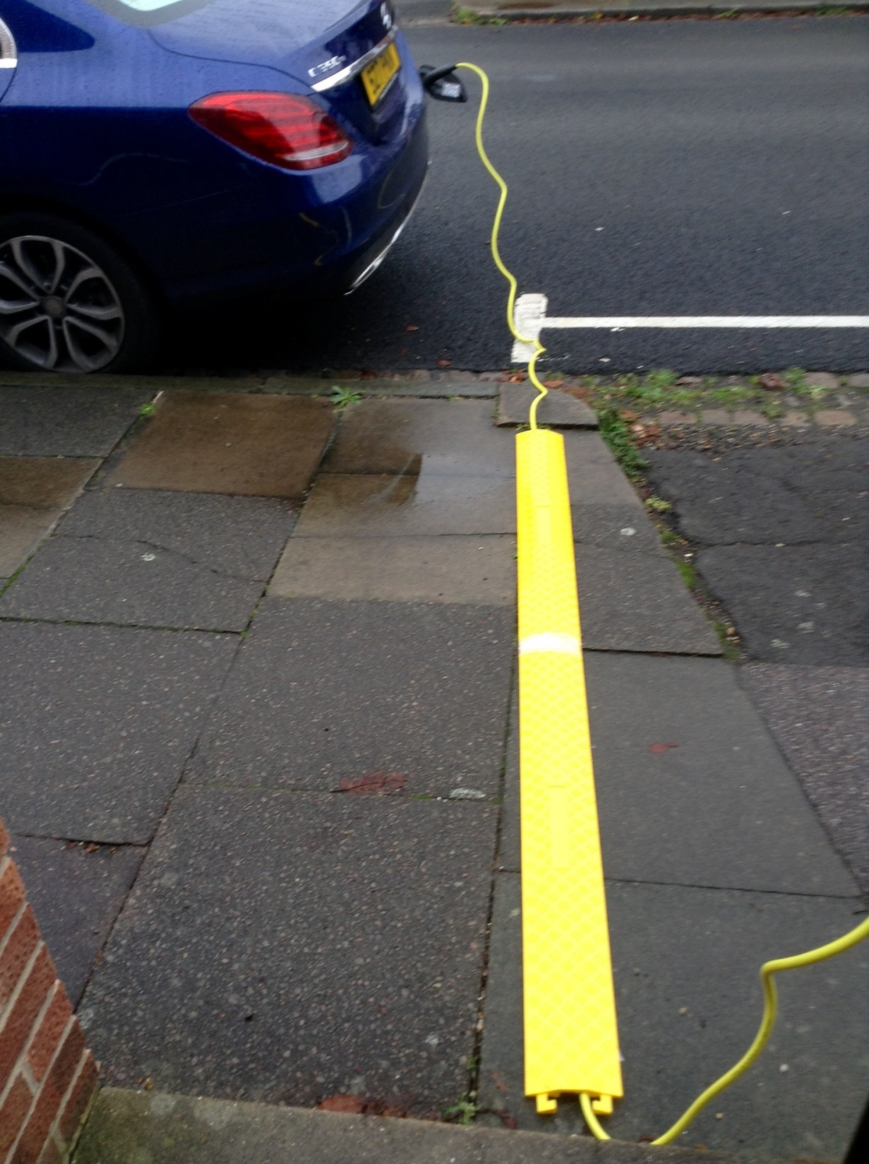
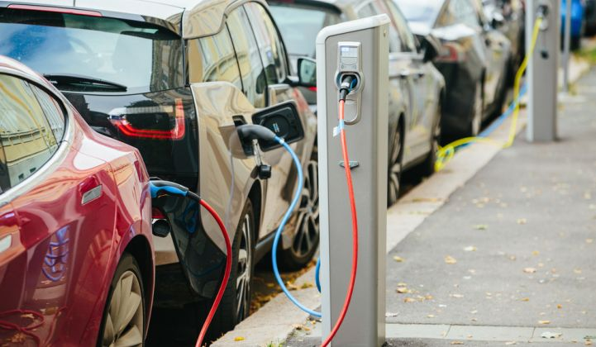
EV Charging/Parking

Slide 30
Parking – a teaser
New structure
Metering/intelligent management
Enforcement
Residential neighborhoods
Administrative management

Slide 31
Next Meeting Date:
Thursday, January 30, 2019, 6 p.m.
Room 224, City Hall

